Slide 1
Health Literacy Summit 2017
Kathy Ingram
Director, Multi-Sector Development

Slide 2
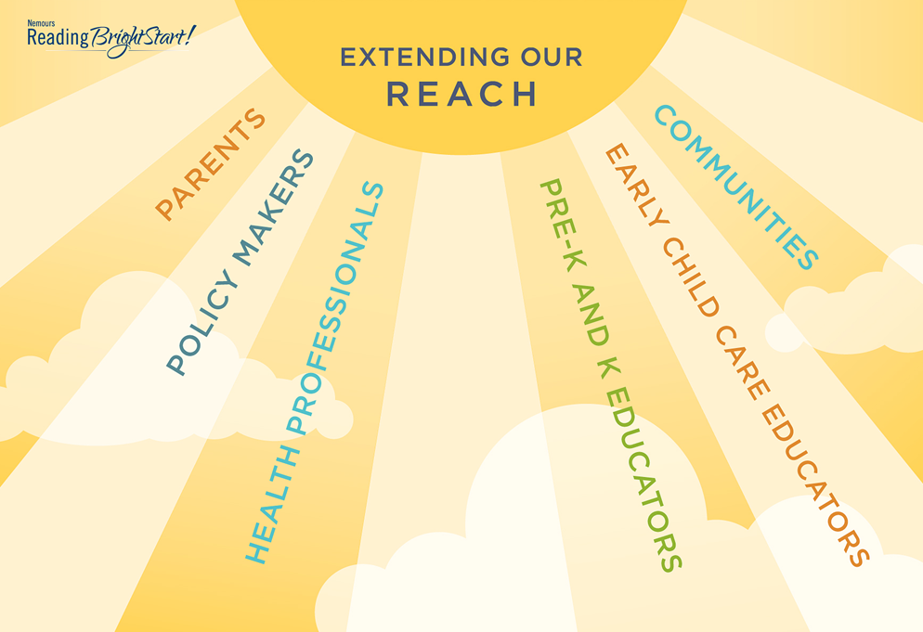
Notes:
Nemours extends far beyond the walls of physician’s offices, clinics and hospitals. We reach into communities meeting children and families where they live work and play.
Today we will talk with you about two innovative digital resources Nemours has employed to improve clinical practice and children’s lives. First we begin with Nemours BrightStart!

Slide 3
Notes:
FOR more than 10 years, the Nemours BrightStart! program has worked to act early, to close the gap that exist between children on early learning skills before they ever have a chance to fail. Used in 25 states across the country and in about 2/3 of the counties of Florida; Nemours BrightStart is a:
When literacy skills are addressed early, especially with children who may be at risk for reading failure the achievement gap between low-performing children and their typically developing peers narrows.
You might be wondering, why one of the largest pediatric health systems in the country would have such a high interest in early literacy.

Slide 4
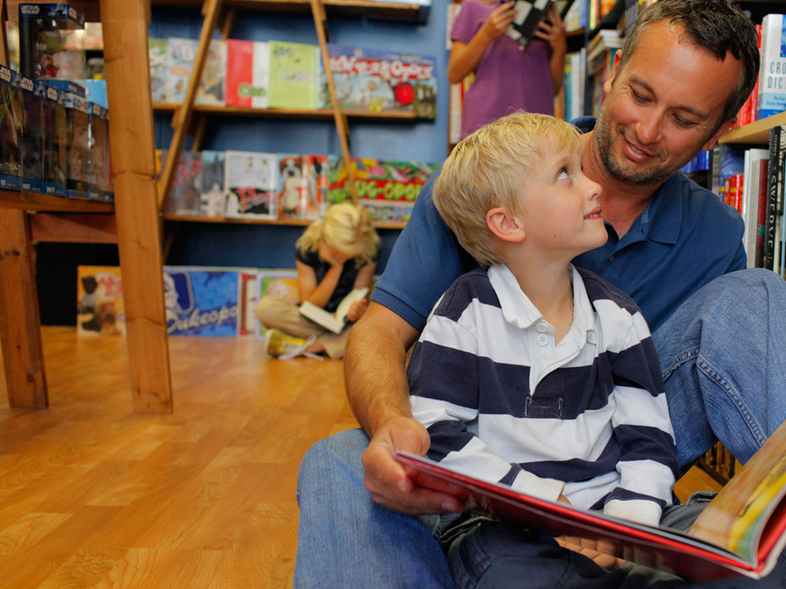
- Bold, innovative approach
- Identifies children at-risk for reading problems
- Provides targeted educational activities and parent empowerment tools
- Conducts and publishes research to demonstrate effectiveness
Notes:
We’ve developed curricula, professional development, and parent tools to support all sectors in helping to build early learning and reading readiness.
But WHY?

Slide 5
Notes:
Why would Nemours, a pediatric health system be interested in literacy? Simple. Literacy is a stronger predictor of a person’s health than their age, socioeconomic status, education or ethnicity.
Adolescents with low literacy are more likely to drop out of school resulting in higher levels of unemployment or underemployment.
And people who are poor and/or illiterate are more likely to work under hazardous conditions or be exposed to environmental toxins
People who have low literacy have higher numbers of hospitalizations, er and outpatient visits
They suffer increased complications of diabetes including blindness, cardiovascular disease and neuropathy
They are less likely to participate in screenings and prevention programs including childhood immunizations, smoking cessation, mammograms and colonoscopies
They have more difficulty understanding and using health information and are 3.4 times more likely to not take medication as prescribed
The connection between literacy and health is essential.

Slide 6
EARLY INTERVENTION AND PARENT ENGAGEMENT
ARE THE KEY TO PREVENTING THE SYMPTOMS THAT OFTEN ACCOMPANY
LOW ACADEMIC ACHIEVEMENT
©2016. The Nemours Foundation. All Rights Reserved.
Notes:
Lets begin at the beginning …. Laying the foundation for a lifetime of literacy begins at birth or even before

Slide 7
Literacy Statistics
Reading aloud to infants helps stimulate brain development yet only half of infants are routinely read to by their families
By age 3, a 30 million word gap is evident among children of diverse home environments
40% of children entering Kindergarten lack pre-literacy skills needed for success
A child who finishes 2nd grade without being able to read has only a 1:4 chance of catching up by the end of elementary school
A child who is not a fluent reader by 4th grade is likely to struggle with reading in adulthood.
65% of 4th graders nationwide scored “below proficient” and 2/3 of 8th graders do not read at grade level
Notes:
While it is possible to change the trajectory of low literacy once it begins, it is difficult and expensive, and unfortunately without focused intervention, it is unlikely to occur.

Slide 8
Poor reading and writing skills
have a devastating lifelong
Impact. 75% of school dropouts
report reading problems and at
least half of adolescents and
young adults with criminal
records have reading
difficulties.
©2016. The Nemours Foundation. All Rights Reserved.
Notes:
If we consider the directs links of literacy or low literacy, to education, risky behaviors, high school dropout rates, incarceration, and welfare, it is easy to see that literacy is the tool to, not just improve overall health, but to break the intergenerational cycle of poverty and its associated health morbidities.
At Nemours we believe our responsibility is more than the diagnosis and treatment of disease. We see ourselves as promoting children’s health and joy – and feel literacy is essential for both.
We’ve talked about how literacy impacts health – but can health care systems impact literacy? That was the question for our Nemours BrightStart program about 10 years ago. And we are pleased to report that the Nemours BrightStart! program developed a 9-12 hour community based intervention that brings approximately two-thirds of preK children identified with low levels of reading readiness back to the normal range , or helps eliminate the gap that already exists at age four.

Slide 9
ONE OF THE
BIGGEST PREDICTORS OF
A CHILD’S SUCCESS IN SCHOOL
IS WHAT HAPPENS
AT HOME
Notes:
Just as in health, parents are our partners. Parent’s are essential as partners in the path to literacy; they are their child’s first teacher and regardless of their own literacy levels – they can help to build a literacy rich environment for their child, and help break the legacy of limited literacy if they only know how.

Slide 10
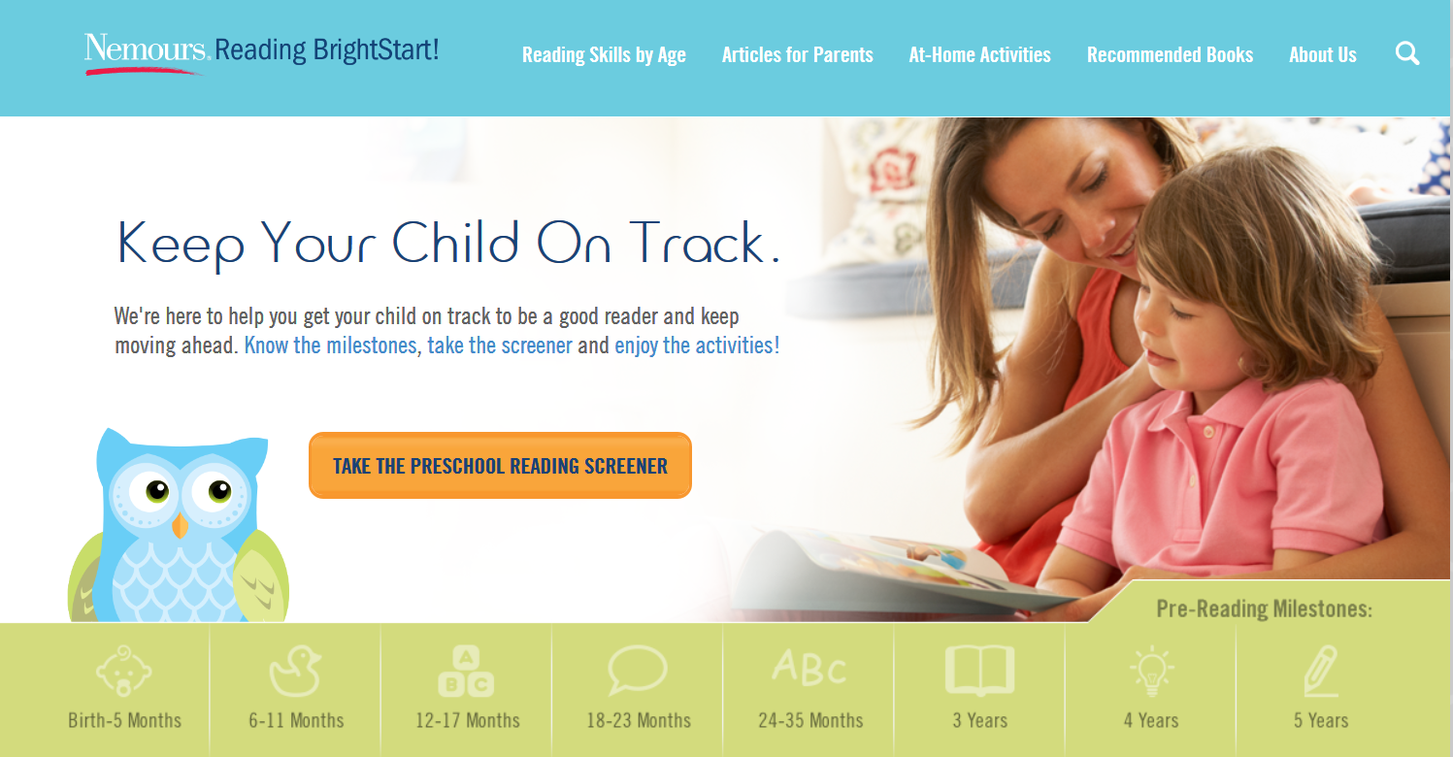
www.readingbrightstart.org
Notes:
Nemours BrightStart! developed a website with tools to help parents know how to help their children be prepared to learn to read. There are developmentally appropriate articles, fun activities and recommended books on the site – but one of the most valuable and frequently visited areas of the website is the preschool reading screener.
Just like screening for vision and hearing, we believe that reading readiness screening helps all children. The Preschool Reading Screener is designed to be used by parents, to get a snapshot of where their age 3, 4, and 5 year old child is on the road to reading readiness, and how to help them along the way.
I want to share that screener with you now. Take out your phone – go to the website now, www.reading brightstart.org.
Find the owl and go to the screener. Make up a child, and answer the first few demographic questions and get started with the screener.
You see the 31 questions, parents answer or check “no” if the parent is unsure.
Quickly answer the questions – CHECK NO on allowing us to use your results (this is for research purposes) and submit.
You will see the customized action plan that parents can use to help their child with specific activities for their child’s needs. Parents are encouraged to return at least every year to watch their child’s progress. The activities and recommended books can be searched by the skill set, so the parent can focus their time on the areas that will most benefit their child.
The site is free and fully optimized for mobile. Over 13,000 families, from all 50 states have used the screener, to help build literacy – the foundation of health literacy.
We will be releasing a summary of the results from these families in early March.

Slide 11
Questions?
©2016. The Nemours Foundation. All Rights Reserved.
Notes:
We’ve talked about how literacy impacts health – and showed one way, the Preschool Reading Screener, that health (Nemours) is using digital strategies to impact literacy.
When a child has a chronic illness, or limited access to healthcare, they are often absent from school and unable to participate in educational activities. If a child isn’t present, they miss the consistent teaching and learning opportunities received by their peers in their classroom and often fall behind. Let’s look at another digital strategy Nemours is using to address literacy – CareConnect.

